Slide 1
Assessment: Kiwi Kars
Portfolio for 3.7 / 3.8
- Russell Nicholson

Slide 2
Create Project Management Tools

Slide 3
Step 1 : Define your relevant implications
What are 3 relevant implications you will be focusing on?
Copyright
Aesthetics
Usability

Slide 4
Step 1 : Define your audience
Who is your target audience?
the website/program I will be creating will be for the purpose of hiring cars so the people I will need to target and design the website for is likely people over the age of 18 and older, I will need to design it with other nationality's in mind as well because a large base of clients that I may have are tourists that need a car to travel around the city or even country
How are they most likely going to be viewing your GUI?
My GUI will most likely be viewed on a desktop browser such as chrome or potentially on a smartphone such as iPhone or Android or a third platform might be a tablet. Due to the range of platforms/devices that my program might be viewed from I need to make sure my program is versatile

Slide 5
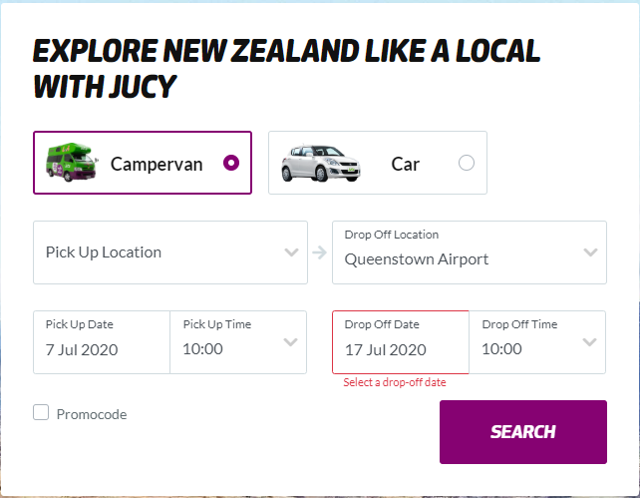
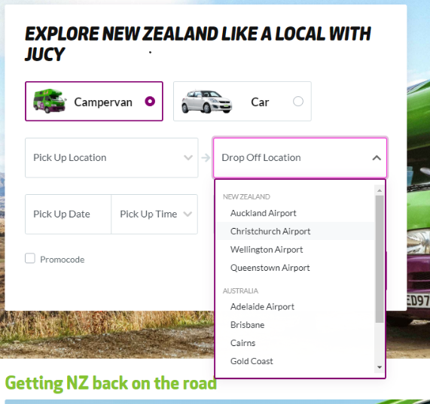
Research

Slide 6
Specifications
Create an online reservation form
Allow users to reserve a vehicle
Add on a mandatory $20 per day insurance fee plus a one off standard booking fee of $50
Rreservations need to be stored in a real time database
GUI must allow the program to book number of days (max 14 days)
Create a text area for the users to add any additional comments.
The top of the page must contain their Company name and logo heading
A footer containing their contact details
The GUI should clearly display each of the vehicles with a photo, daily hire price and their corresponding description
The user should then be allowed to select a vehicle
Allow users to select from extra options (listed above)
Select their number of days – number input (max 14)
Pick up date – date input
A reservation summary which outputs the detail of their reservation with an itemised breakdown of the total cost.
The person booking the car must be older than 25 to make a reservation
GUI should include a header with their logo and contact details in a footer
A checkbox that the user must tick to ensure they agree to our Terms and Conditions
The program must store all of the booking details to a real time Firebase database
Extra items a user can add to their reservation includes:
Snow chains - $60
Roof racks - $90
Bike rack (fits max 3 bikes) - $120
GPS - $35
Child Booster Seat (9kg -36kg) - $50
design their colour palette/fonts and have provided 2 different logos and wish for the design to be modern and sleek

Slide 7
Define the key steps of this project
Record the client specifications
Create Trello board to manage tasks
Ideate (wireframe (GUI), Google fonts / colours)
Prototype: Create the GUI, test inputs work, perform calculations, test outputs, form validation and error messages, create firebase project, connect to firebase and push data
Testing : ongoing and should involve A vs B testing with end users

Slide 8
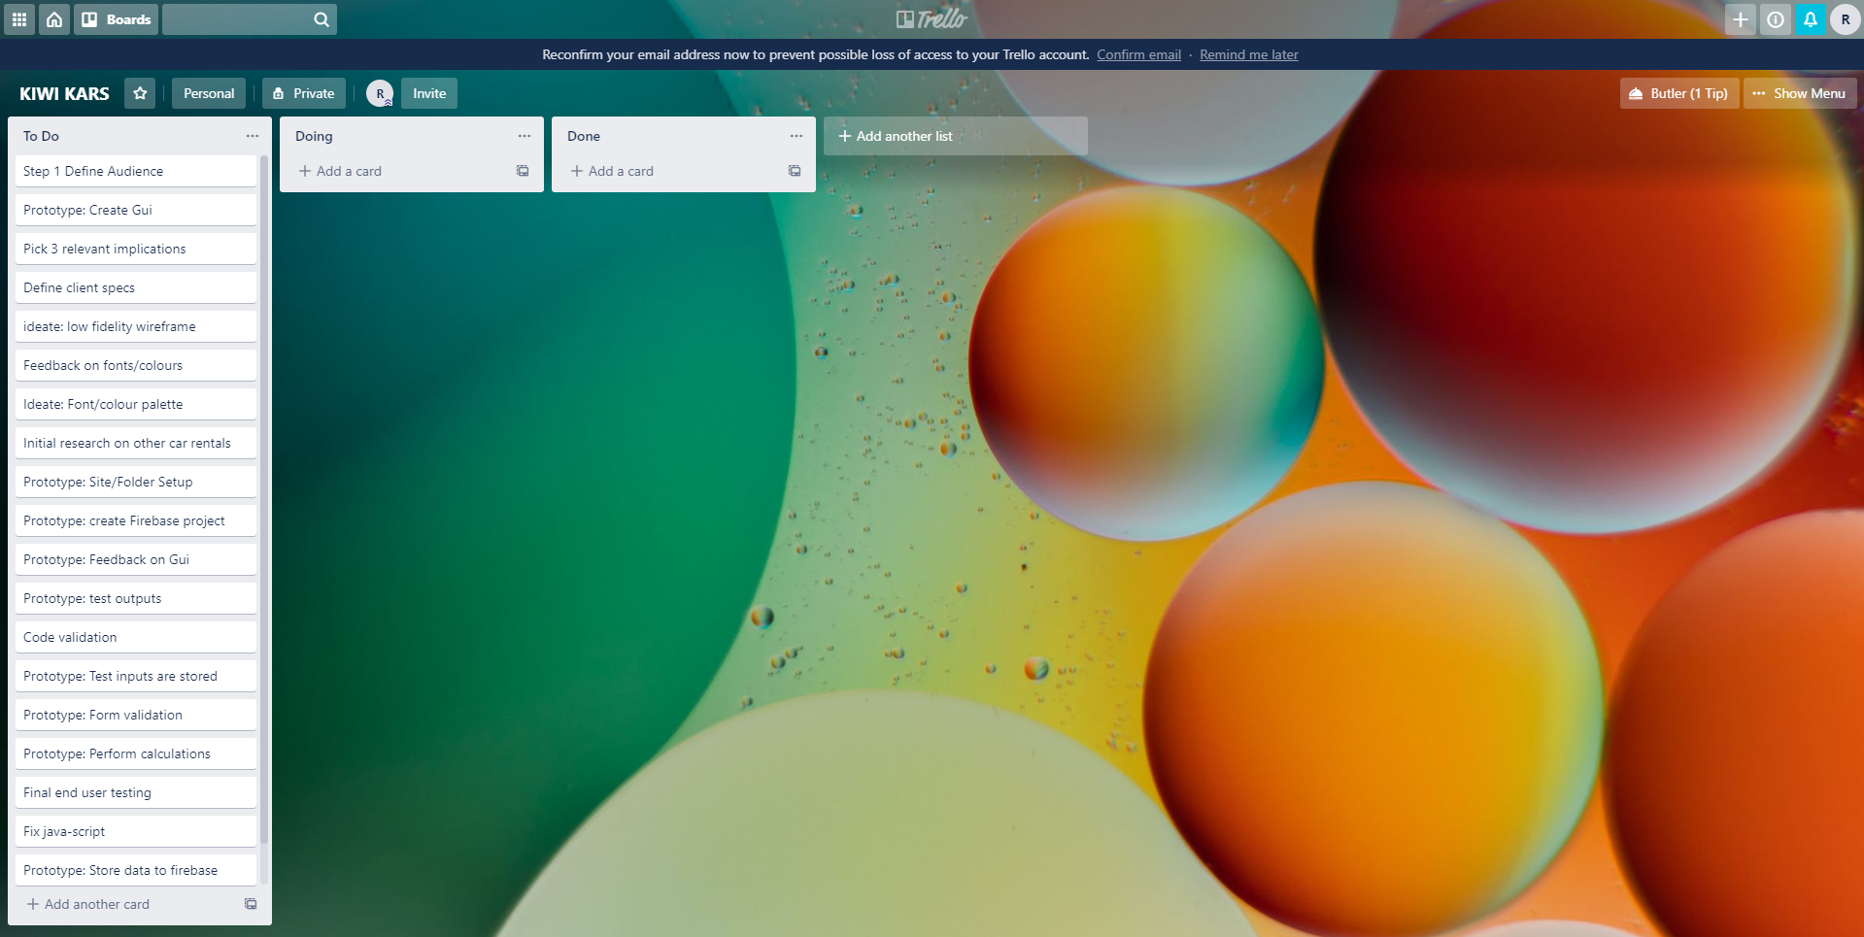
PROJECT MANAGEMENT TOOL: TRELLO
https://trello.com/invite/b/RUFJ9k0z/04412a841ad58f4098e4a6ca7489d1df/kiwi-kars

Slide 9
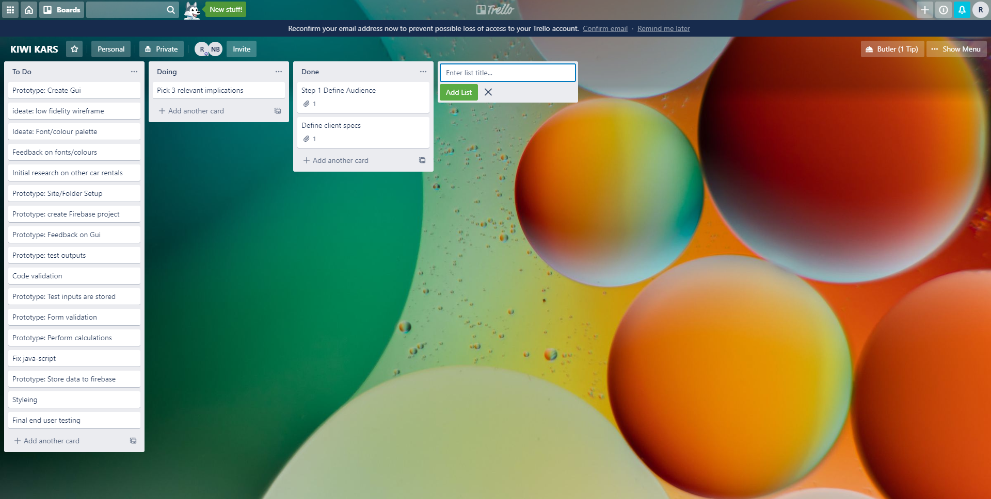
PROJECT MANAGEMENT TOOL: TRELLO
https://trello.com/invite/b/RUFJ9k0z/04412a841ad58f4098e4a6ca7489d1df/kiwi-kars

Slide 10
PROJECT MANAGEMENT TOOL: TRELLO

Slide 12
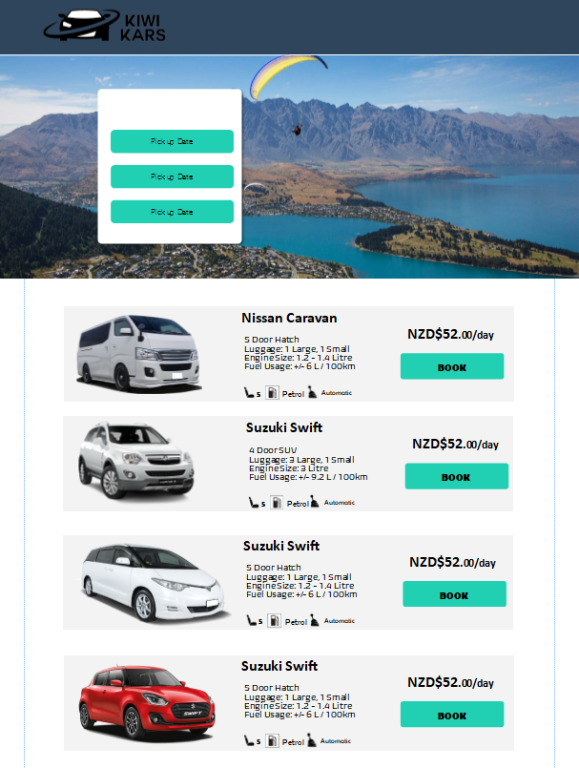
Step 2:Ideate (high fidelity wireframe)

Slide 13
Wireframe feedback

Slide 14
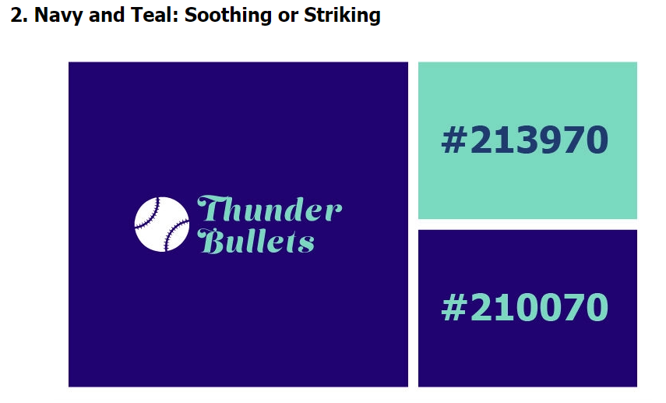

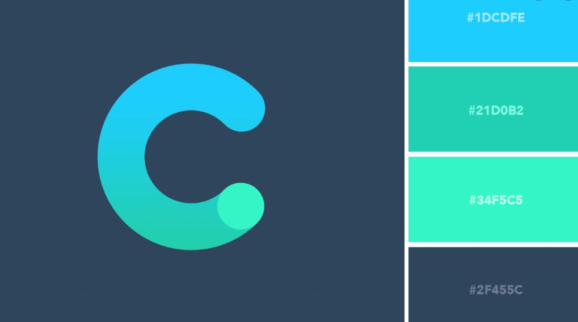


Font/colour combinations
Colour: 11
Colour: 1
Font: 11
Font: 1
Font: 1 11
Colour: 111
Font: 11

Slide 15
Feedback on fonts/colours

Slide 16
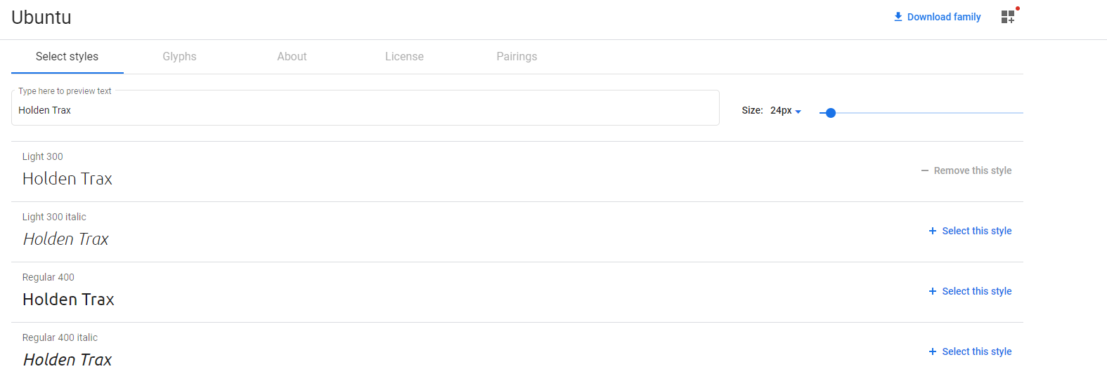
Chosen fonts and colours

Slide 17
Site set up

Slide 18

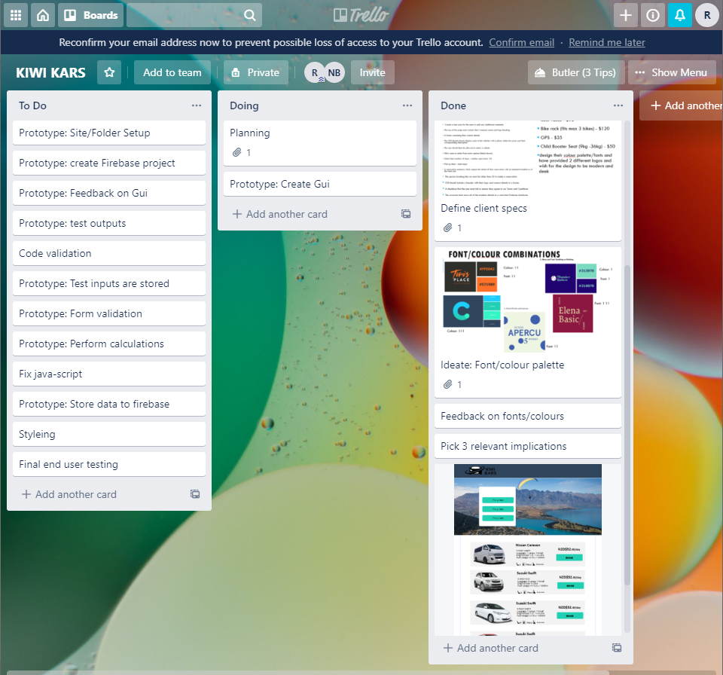
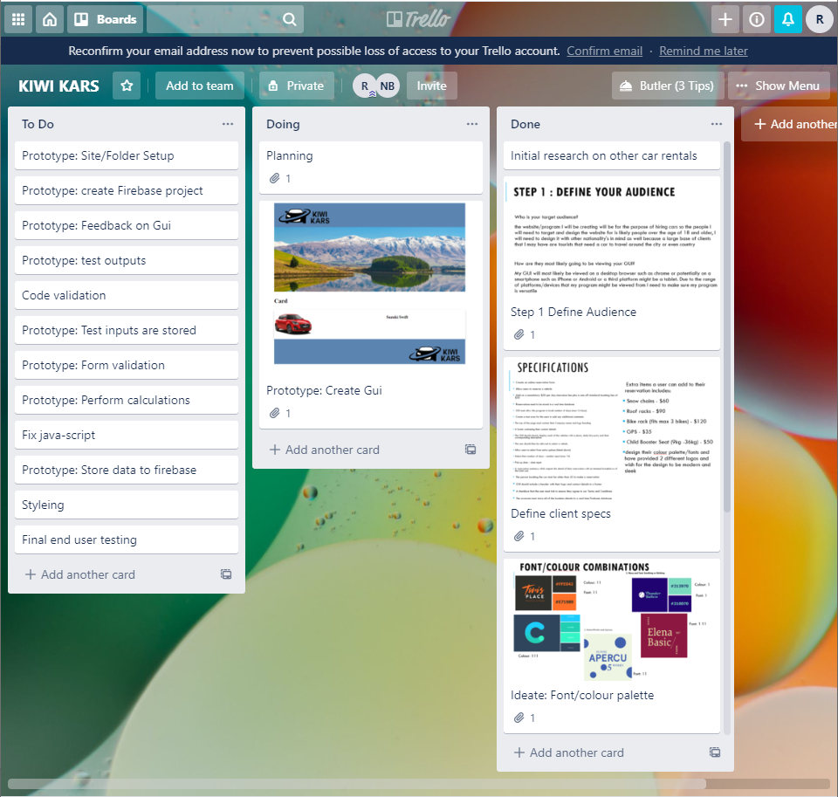
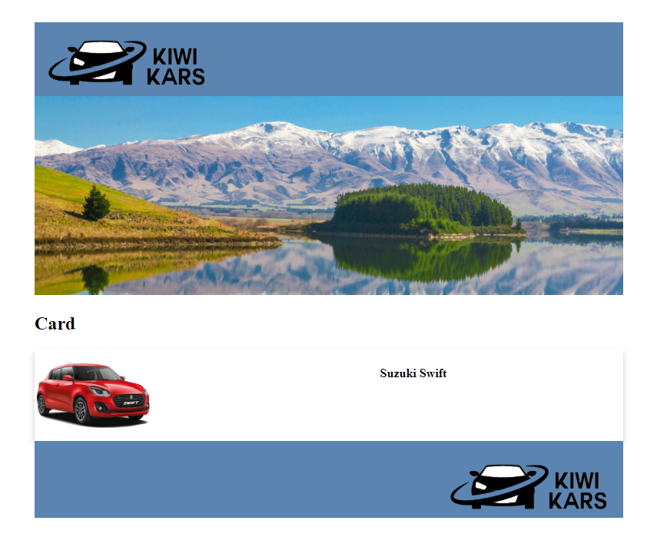
Set up the GUI
First day header/footer
Day two starting cards

Slide 19
feedback
Colours are nice and easy to look at. It would be nice for some extra pops of colour when you add buttons and stuff ☺
Lots of empty space around the page
The cards selection box are quite far down. If I click on a card, it sometimes registers the card above it instead.

Slide 20
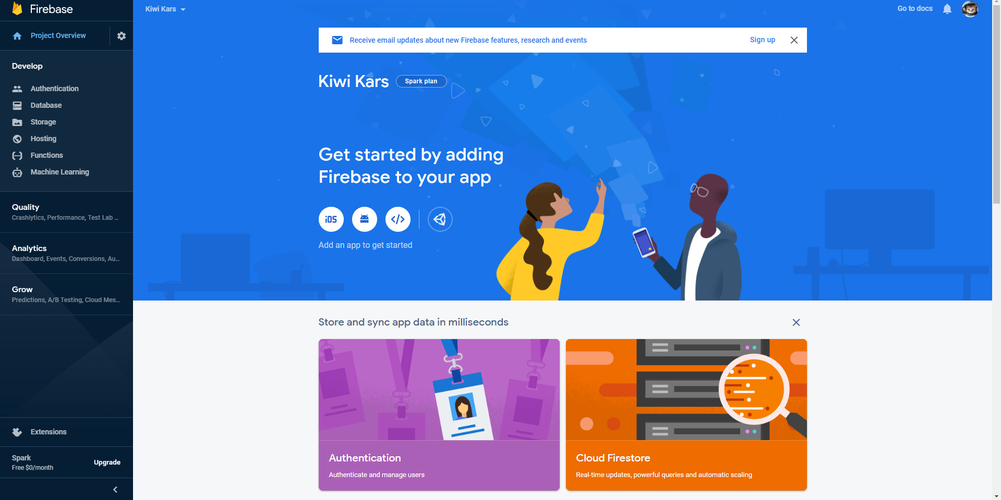
Firebase

Slide 21
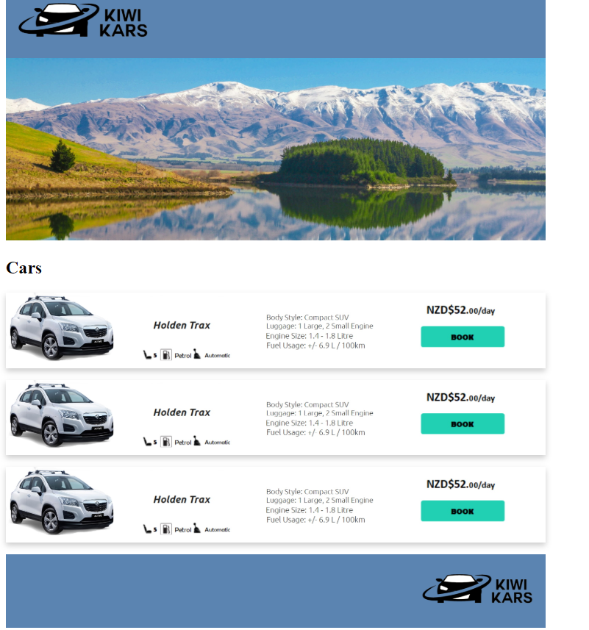
progress

Slide 22
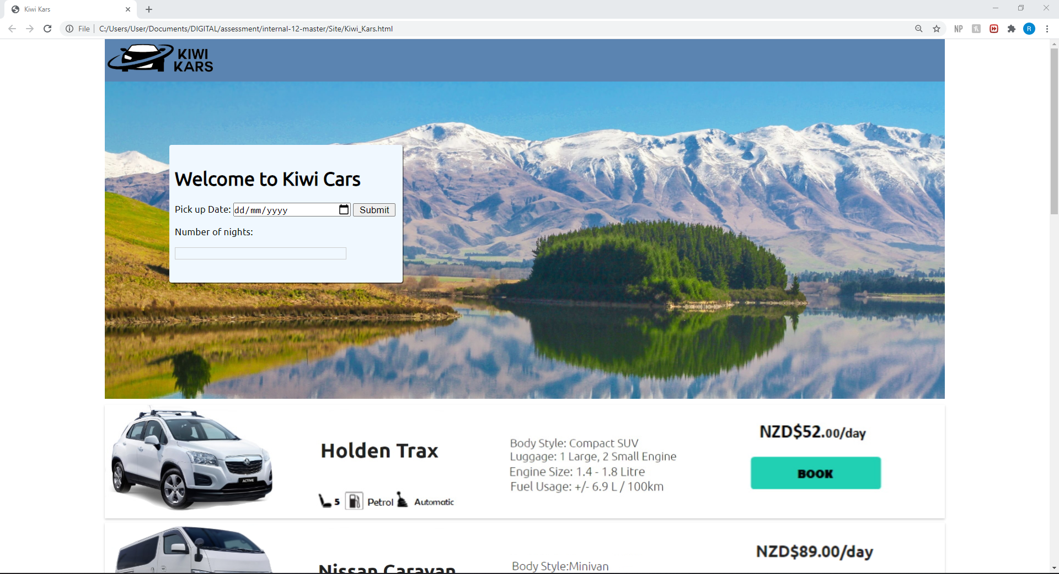
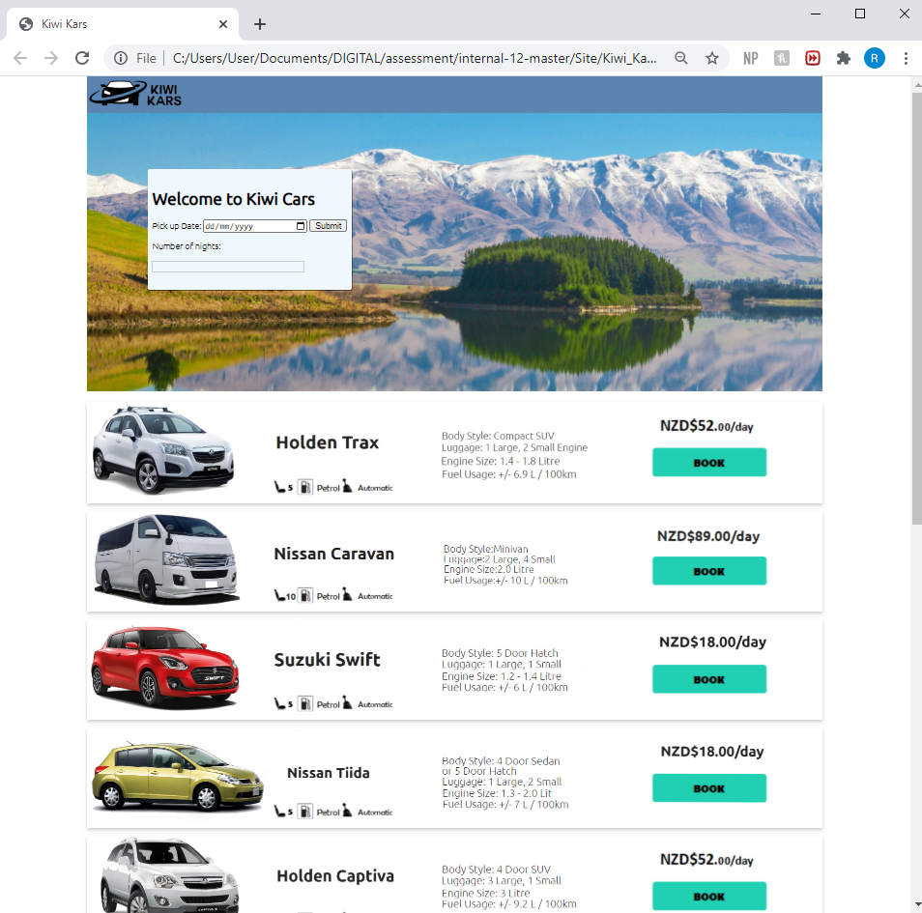
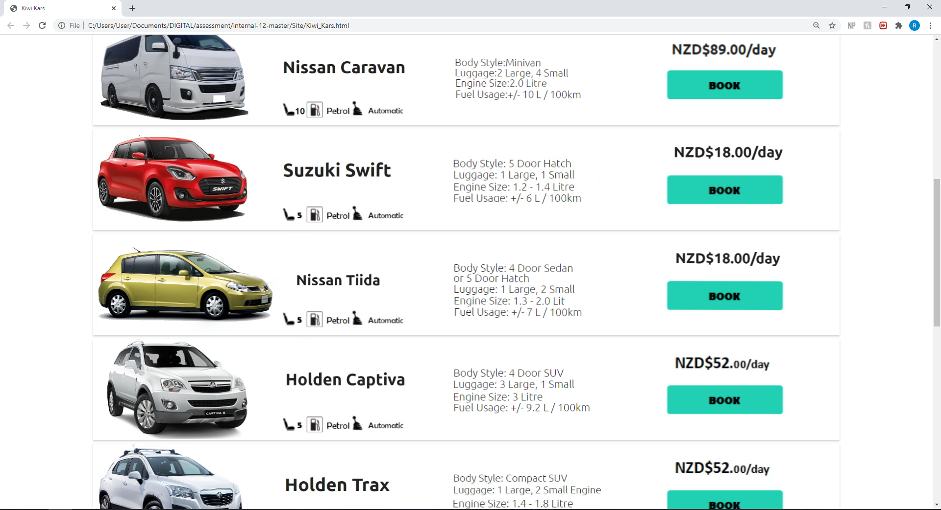
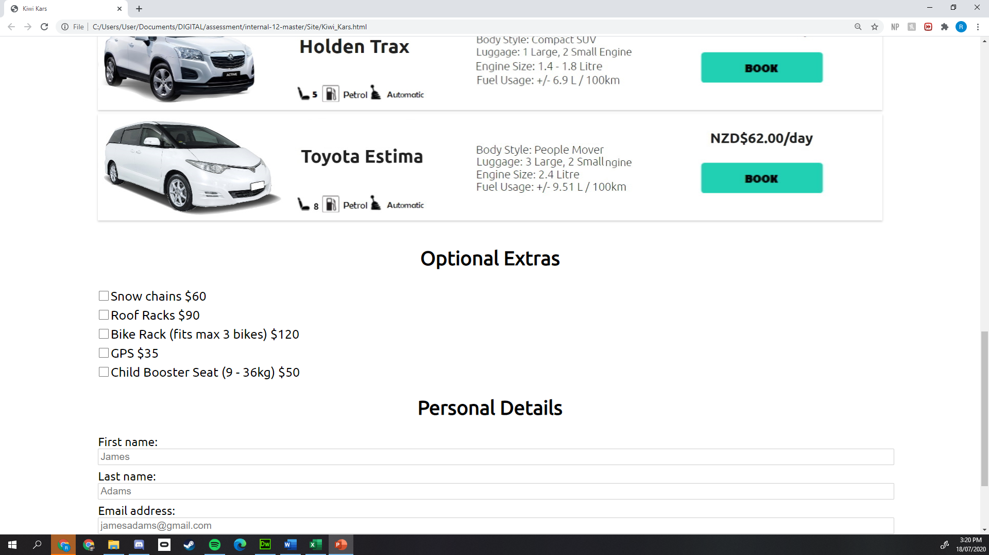
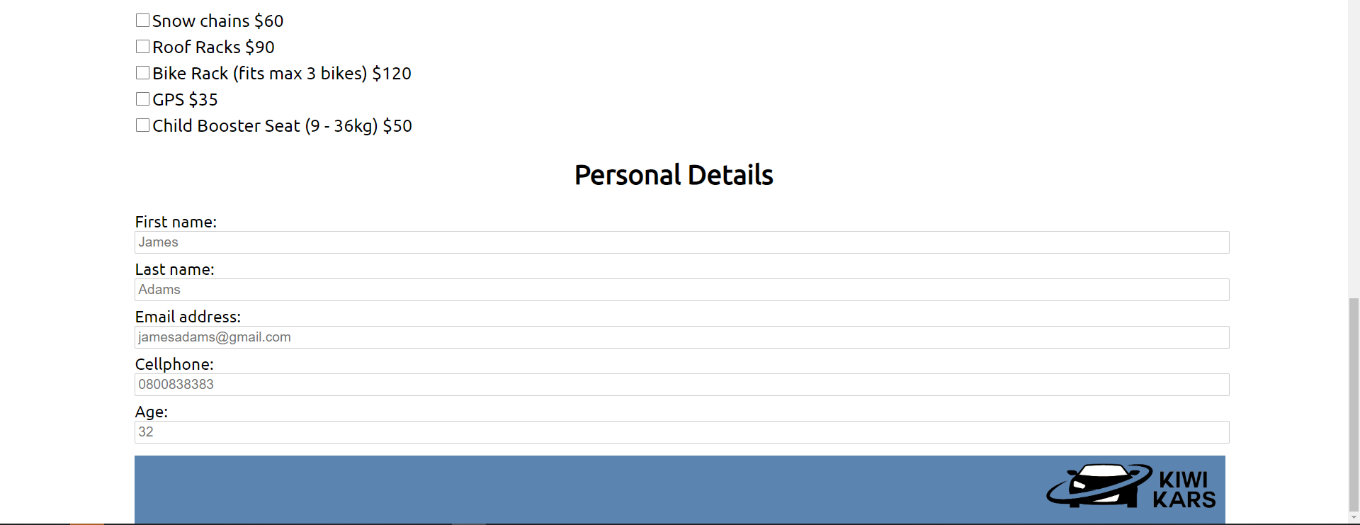
progress
Fully saleable

Slide 23
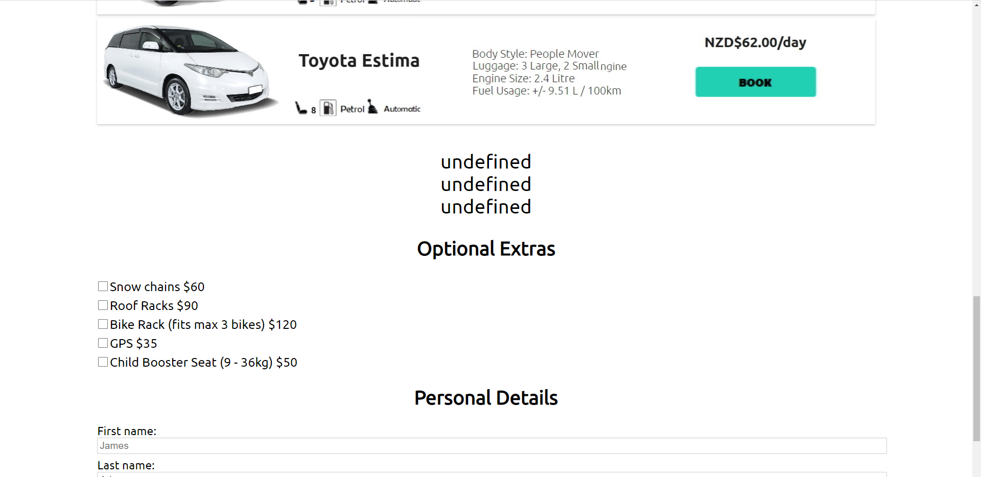
progress
Still have undefined error values for the car details

Slide 25
Trialing inputs

Slide 26
Every LESSON – TAKE A SCREENSHOT OF YOU USING YOUR TRELLO BOARD – ADDING NOTES TO YOUR CARDS ETC AND A SCREENSHOT OF YOUR CODE AND GUI

Slide 27
Trialing inputs

Slide 28
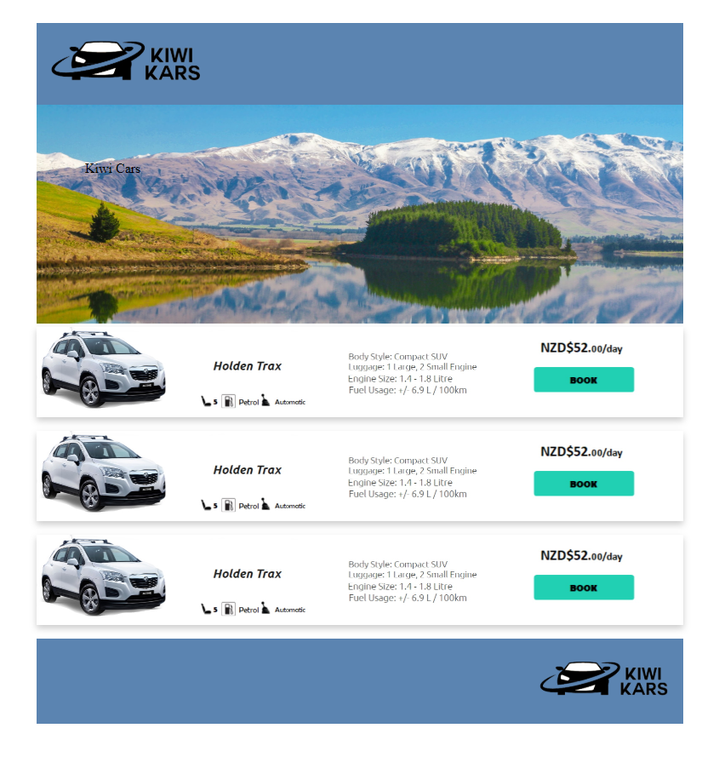
Aesthetics / functionality feedback
Aesthetics
Make the cards stand out from the page more.
Card design looks great
Remove kiwicars text on the image
Stop focussing on the layout and just start adding content to the page.

Slide 29
FEEBACK ON THE ASETHETHICS

Slide 30
FEEBACK ON THE USABILILTY

Slide 31
Trialing layouts

Slide 32
Trialing outputs / error messages

Slide 33
Trialing outputs / error messages

Slide 34
Improving the functionality

Slide 35
Trialing outputs / error messages

Slide 36
Debugging : works on expected data

Slide 37
Debugging : works on expected data

Slide 38
Debugging : works on expected data

Slide 39
Debugging : works on expected data

Slide 40
Debugging : works on expected data

Slide 41
Debugging : works on boundary data

Slide 42
Debugging : works on boundary data

Slide 43
Debugging : works on invalid data

Slide 44
FEEDBACK ON GUI

Slide 45
REFINEMENTS

Slide 46
REFINEMENTS

Slide 47
REFINEMENTS

Slide 48
Evidence of Code Validation (html)

Slide 49
Evidence of Code Validation (css)

Slide 50
Evidence of Code Validation (JS)

Slide 51
Evidence of code comments (HTML/CSS/JS)

Slide 52
Persistent Storage (Firebase database) SETUP

Slide 53
Persistent Storage (Firebase database)
Firebase database

Slide 54
Persistent Storage (Firebase database)
Final video of testing evidence / split screened GUI with Firebase

